Slide 1

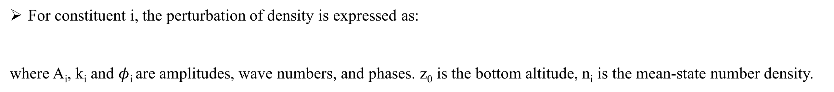
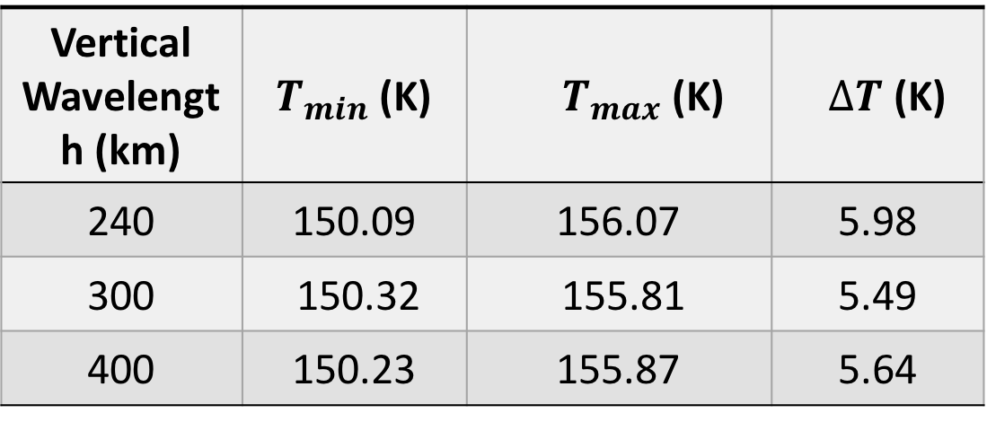
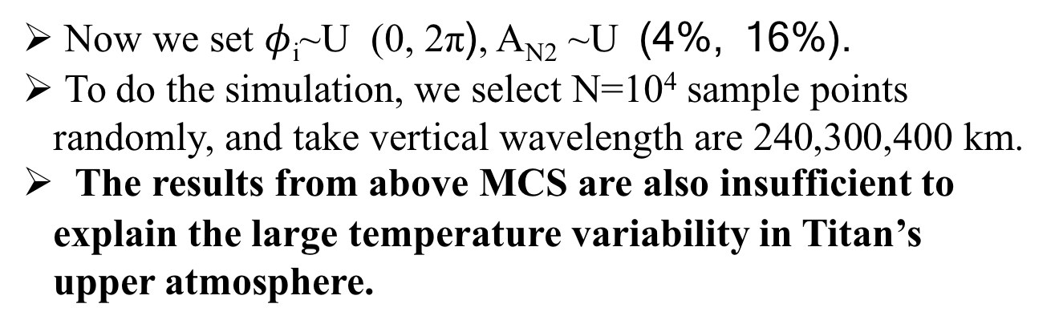
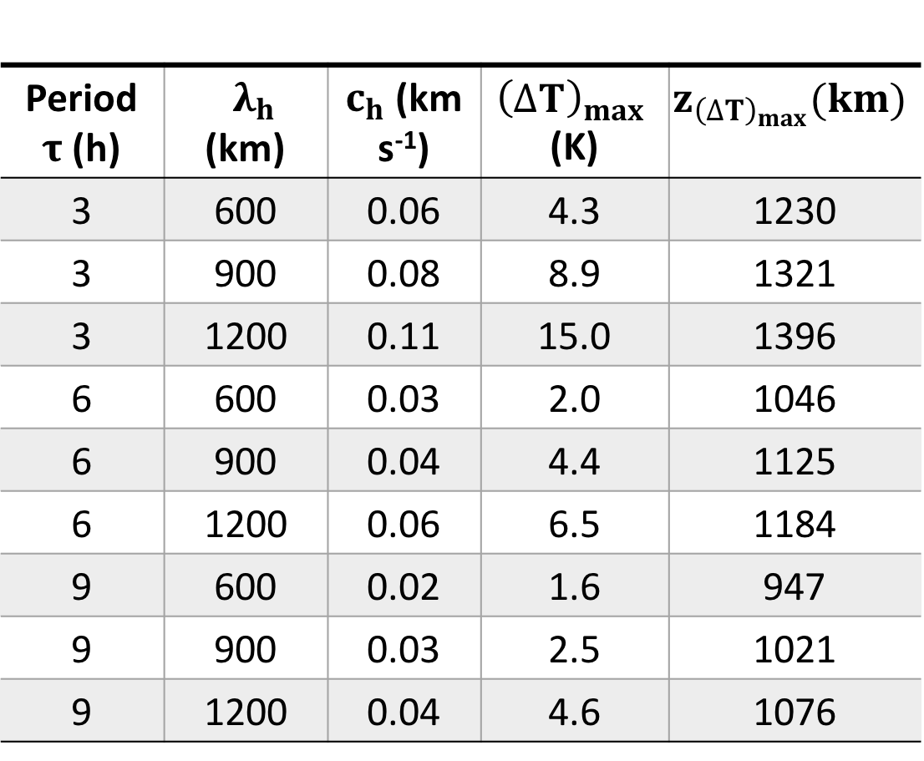
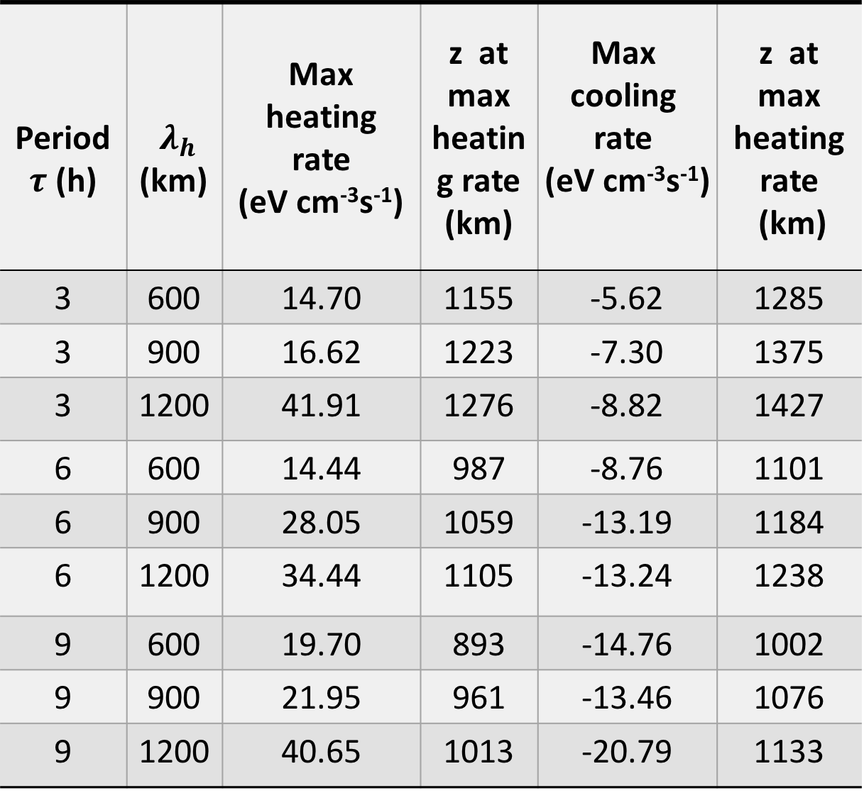
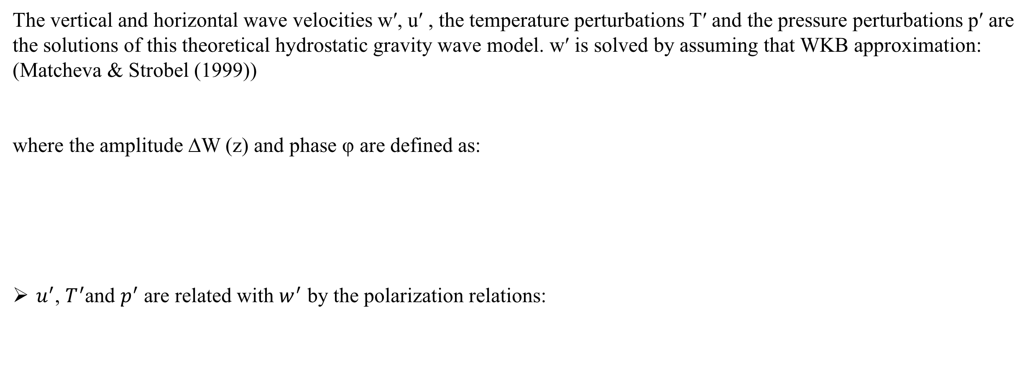
Temperature Variability in Titan's Upper Atmosphere:
The Role of Wave Dissipation
Xing Wang^{1,2}, Jun Cui^{1,3,4} , Yuan Lian⁵ CGU Meeting, BEIJING, October 2018
Abstract
The mean isothermal temperature of Titan‘s upper atmosphere varies between 110 and 180 K based on the Cassini Ion Neutral Mass Spectrometer (INMS) measurements (Westlake et al. 2011, Snowden et al. 2013). Existing studies have investigated a number of driving forces including solar EUV heating, magnetospheric electron impact heating, and Joule heating, but none of them contributes to the observed temperature variability (Snowden & Yelle 2014). We investigate in this study the role of wave dissipation, as motivated by the observations of extensive wave structures in Titan’s upper atmosphere (Cui et al. 2014). For this purpose, we construct a simple linearized model of wave propagation in Titan’s upper atmosphere based on the WKB approximation (Matcheva & Strobel 1999), from which the energy flux and heating rate are calculated as a function of altitude for several selected wave modes likely present on Titan. Our calculations reveal a maximum heating rate of 40 eV cm³ s⁻¹ at around 1280 km, which is only half of the solar EUV heating rate at the same altitude. This implies that wave dissipation is not very likely to be a viable mechanism causing substantial temperature variability in Titan’s upper atmosphere. We further speculate that such a temperature variability is an observational bias provided that the characteristic wavelength is comparable with the vertical extent over which the INMS sampled the ambient atmosphere along a typical Cassini encounter with Titan. A Monte Carlo simulation is implemented to verify the above speculation, but we find that, for a reasonable choice of wave parameters, the modeled temperature variability is far insufficient to account for the observations.
Introduction
Hydrostatic Gravity Wave Model
Earlier observational data came from Huygens probe and Cassini fly-bys indicated that the thermal structure of Titan’s atmosphere is variable and highly complex. The analysis of INMS data in Snowden et al. (2013) showed that the median temperature on the upper atmosphere varied between 112 and 175 K. Therefore, the temperature of Titan’s upper atmosphere varies approximately 60 K.
de La Haye et al. (2007) found that the dayside temperature in Titan’s upper atmo- sphere doesn’t higher than the nightside value by assuming that the energy source only is solar heating radiation, then the solar heating radiation can not to explain this energy crisis phenomenon.
The analysis by Snowden & Yelle (2014) indicated that magnetospheric particle precipitation only increases the temperature of Titan’s upper atmosphere by 7 K, they are also found that Joule heating and the diurnal variation in HCN abundance can increase in temperature from 145 to 165 K above 1200 km.
Müller-Wodarg et al. (2006) found that the energy and momentum were absorbed into Titan’s upper atmosphere as wave dissipates, and found that the maximum energy carried by waves is about 1.25×10⁹ eV cm⁻² s⁻¹.
Further analysis by Snowden & Yelle (2014) showed that wave propagation and dissipation can heating or cooling the thermal structure of Titan’s upper atmosphere. However, they just estimated the viscous flux of kinetic energy on the order of 30 eV cm³ s⁻¹ at an altitude of 1300 km and the cooling rate due to the sensible heat flux is about -9 eV cm⁻³ s⁻¹ for a weakly damped wave, and didn’t to calculate in detail.
The analysis of INMS data in Cui et al. (2013) showed that the observed waves in Titan’s upper atmosphere are upward propagating gravity waves and the wavelength is ≈ 730 km and the wave period is ≈ 10 h.
The vertical and horizontal wave velocities w′, u′ , the temperature perturbations T′ and the pressure perturbations p′ are
the solutions of this theoretical hydrostatic gravity wave model. w′ is solved by assuming that WKB approximation:
(Matcheva & Strobel (1999))
where the amplitude ∆W (z) and phase φ are defined as:
$u^{′}$, $T^{′}$and $p^{′}$ are related with $w^{′}$ by the polarization relations:
Propagation and Amplitude of Gravity Wave
Heating or Cooling Rate of Gravity Wave
The analysis by Cui et al. (2013) show that the range of gravity wave period is 80 min to 10 h.
We select 9 wave models and the properties of these waves are listed in table 1.
The vertically propagating gravity waves can heating or cooling the Titan’s atmosphere because they can transport energy and momentum stresses upwardly.
The profiles of heating or cooling rate for 9 wave models are showed in fig.2. The maximum heating/cooling rates of the total vertical energy fluxes and their altitudes are listed in table 2.
Table 1. Summary of gravity wave parameters and the maximum temperature amplitudes and the altitudes at which the waves have their maximum amplitudes
Period $τ$ (h) | $λ_{h}$ (km) | $c_{h}$ (km s⁻¹) | ${\left(∆T\right)}_{max}$(K) | $$z_{{\left(∆T\right)}_{max}}(km)$$
3 | 600 | 0.06 | 4.3 | 1230
3 | 900 | 0.08 | 8.9 | 1321
3 | 1200 | 0.11 | 15.0 | 1396
6 | 600 | 0.03 | 2.0 | 1046
6 | 900 | 0.04 | 4.4 | 1125
6 | 1200 | 0.06 | 6.5 | 1184
9 | 600 | 0.02 | 1.6 | 947
9 | 900 | 0.03 | 2.5 | 1021
9 | 1200 | 0.04 | 4.6 | 1076
Table 2. Summary of the maximum heating/cooling rates of the total vertical energy fluxes and the altitudes at which the waves have their maximum heating/cooling rates
Period $τ$ (h) | $λ_{h}$ (km) | Max heating rate (eV cm⁻³s⁻¹) | z at max heating rate (km) | Max cooling rate (eV cm⁻³s⁻¹) | z at max heating rate (km)
3 | 600 | 14.70 | 1155 | -5.62 | 1285
3 | 900 | 16.62 | 1223 | -7.30 | 1375
3 | 1200 | 41.91 | 1276 | -8.82 | 1427
6 | 600 | 14.44 | 987 | -8.76 | 1101
6 | 900 | 28.05 | 1059 | -13.19 | 1184
6 | 1200 | 34.44 | 1105 | -13.24 | 1238
9 | 600 | 19.70 | 893 | -14.76 | 1002
9 | 900 | 21.95 | 961 | -13.46 | 1076
9 | 1200 | 40.65 | 1013 | -20.79 | 1133
Fig. 1. Altitude profiles of amplitude (denoted by ∆T and given by the solid curve) and phase (dashed curve) of 3 h, 6 h, 9 h-wave models.
Fig. 2. Heating and cooling rates due to wave dissipation for 3 h, 6 h, 9 h-wave models.
Discussion
Monte Carlo Simulation
Snowden estimated the viscous flux of kinetic energy on order of 30 eV cm⁻³ s⁻¹ approximately near 1300 km altitude and the wave cooling rate due to the sensible heat flux is -9.0 eV cm⁻³ s⁻¹ in Snowden & Yelle (2014), there are very close to the values by our calculation for the 3-h wave with horizontal wavelength λ_{h} = 1200 km.
Besides, the heating energy flux of EUV is about 4× 10⁸ eV cm⁻² s⁻¹ above 1200 km altitude by Snowden calculation, and the analysing by Müller-Wodarg showed that the globally averaged EUV energy into the Titan’s thermosphere is 3.5 to 5× 10⁹ eV cm⁻² s⁻¹ in Müller-Wodarg et al. (2006). However, in our calculations, the maximum of the total vertical energy fluxes for the 9 waves models is about 3.5× 10⁸ eV cm⁻² s⁻¹, which is lower than the energy flux of EUV by Snowden and Müller-Wodarg calculated.
To compare the heating energy flux between gravity waves and EUV in detail, we simply calculated the altitude profiles of the photoionization heating rate due to solar radiation, which is showed in figure 3.
For constituent i, the perturbation of density is expressed as:
where A_{i}, k_{i} and $φ$_{i} are amplitudes, wave numbers, and phases. z₀ is the bottom altitude, n_{i} is the mean-state number density.
Now we set $φ$_{i}~U (0, 2π), A_{N2} ~U (4%, 16%).
To do the simulation, we select N=10⁴ sample points randomly, and take vertical wavelength are 240,300,400 km.
The results from above MCS are also insufficient to explain the large temperature variability in Titan’s upper atmosphere.
Table 3. Summary of Results of MCS for N₂
Vertical Wavelength (km) | $T_{min}$ (K) | $T_{max}$ (K) | $∆T$ (K)
240 | 150.09 | 156.07 | 5.98
300 | 150.32 | 155.81 | 5.49
400 | 150.23 | 155.87 | 5.64
The maximum heating rate of above 9 waves models is 41.91 eV cm⁻³ s⁻¹ at 1276 km altitude, while the total photoionization heating rate is 82.95 eV cm⁻³ s⁻¹ at the same altitude, and the integrated the total photoionization heating rate is about 1.78× 10⁹ eV cm⁻² s⁻¹ above 1200 km altitude, these values are all higher than the values by dissipations of above 9 waves models.
These results indicates that the dissipations of gravity waves can’t explain the large temperature variability in Titan’s upper atmosphere.
Authors
References
¹ Key Laboratory of Lunar and Deep Space Exploration, National Astronomical Observatories, Chinese Academy of Sciences, Beijing, China. wangxing@nao.cas.cn
² School of Astronomy and Space Science, University of Chinese Academy of Sciences.
³ School of Atmospheric Sciences, Sun Yat-sen University, Zhuhai, Guangdong, China. cuij@nao.cas.cn
⁴ Lunar and Planetary Science Laboratory, Macau University of Science and Technology, Macau, People’s Republic of China.
⁵ Aeolis Research, Pasadena, CA 91107,USA.
1. Cui, J., Lian, Y., & Müller-Wodarg, I. C. F. 2013, Geophys. Res. Lett., 40, 43
2. Cui, J., Yelle, R. V., Li, T., Snowden, D. S., & Müeller-Wodarg, I. C. F. 2013, European Planetary Science Congress, 8, EPSC2013-593
3. Matcheva, K. I., & Strobel, D. F. 1999, Icarus, 140, 328
4. Young, L. A., Yelle, R. V., Young, R., Seiff, A., & Kirk, D. B. 1997, Science, 276, 108
Fig. 3. Photoionization Heating Rate by N₂, CH₄, C₂H₆ and C₂H₂.

